Slide 1
Operator Pull-down Rewriting Rules
Equality-based Selection

Slide 2
The problem
Consider join-less queries using a single remote source S, where P is an SQL++ selection expression in CNF including only equality predicates.
We want to rewrite P in a way that lets the source do as much work as possible.
We focus on equality because this is the most common type of selection predicate.
Less-than comparison is similar but introduces slightly more complexity.

Slide 3
The solution
Query rewriting is a 3 step process :
Create conjunctive predicates such that .
are rewritten into a source-agnostic set of more specific conjunctive predicates.
Source-specific sets are created such that:
can be executed at the source and is as large as possible.
is not executed at the source and is as small as possible.
The following holds :
Source wrappers translate conjunctive predicates into equivalent predicates in the source language.

Slide 4
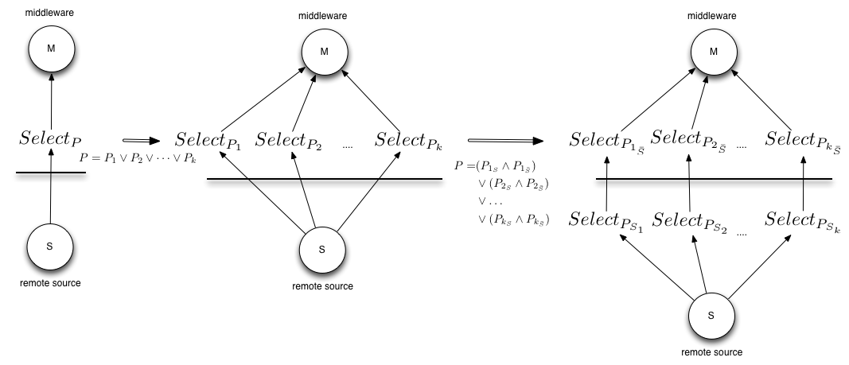
The query rewriting process

Slide 5
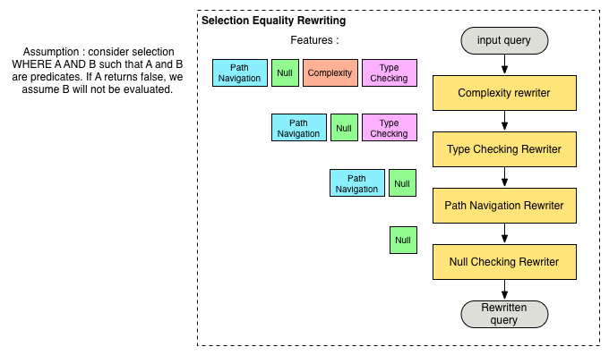
Source agnostic predicate rewriting architecture

Slide 6
Example source-agnostic query rewriting
SELECT customer
FROM S.orders
WHERE customer =
{ name: 'Alice', age: 35 }
OR
customer=22
SELECT customer
FROM S.orders
WHERE customer != missing AND
customer != null AND
customer.name != missing AND
customer.name != null AND
type(customer.name) = string AND
customer.name = 'Alice’ AND
customer.age != missing AND
customer.age != null AND
type(customer.age) = number AND
customer.age = 35 AND
customer.attrs() = {{ ‘name’, ‘age’ }}
OR
customer != missing AND
customer != null AND
type(customer) = number AND
customer = 22

Slide 7
Example source-specific query rewriting

